Slide 1
Image-to-Image Translation with Conditional Adversarial Networks
Pengkai Zhu, Weiwei Tao, Hari Saran

Slide 2
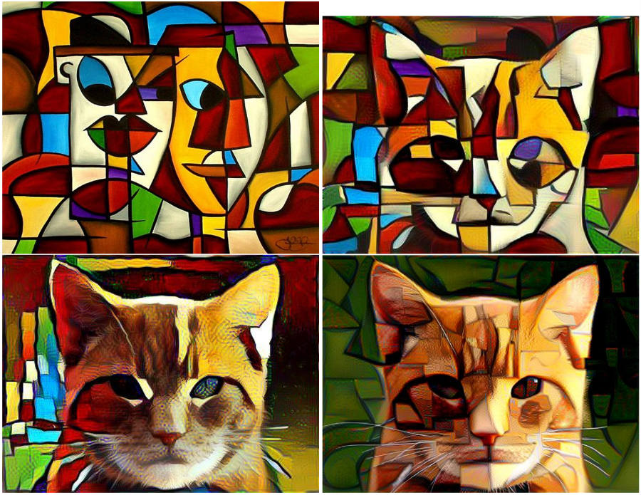
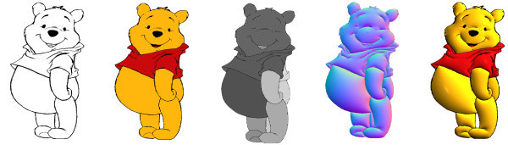
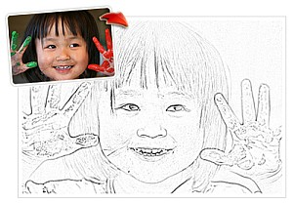
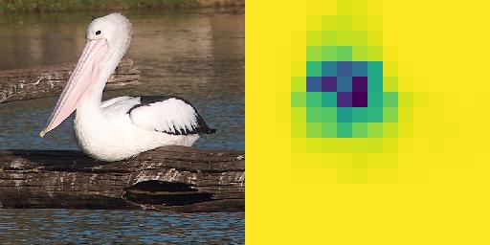
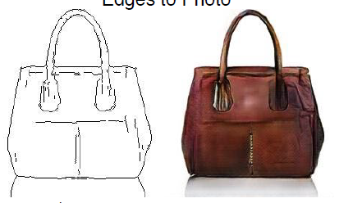
Task
https://www.researchgate.net/figure
http://theusbport.com/google-creatives-explain-style-transfer-turn-photos-art/20027
Isola et al., 2016
http://techpp.com/2010/02/18/convert-photos-to-sketches-online-for-free/
Notes:
http://techpp.com/2010/02/18/convert-photos-to-sketches-online-for-free/

Slide 3
Related work
CNN is used to generate colorful images (Zhang et al., 2016).
GAN (Goodfellow et al., 2014) works well for generating small images.
Conditional GAN is developed to generate high quality natural images (Denton et al.,2015).
Deep convolutional GANs (DCGANs) are more stable to be trained (Radford et al., 2016).
The cGAN objective function is mixed with the traditional L2 loss to generate images, which is proved to give better performance (Pathak et al., 2016).
Call for a method which can deal with all kinds of image processing tasks! (Isola et al., 2016)
Notes:
A lot of methods have being applied to the image translation problems.
the performance of CNN is strongly dependent on loss functions specified by users. Common-used loss function for CNN, such as the Euclidean distance will tend to produce conservative and blurry images
2. GAN can avoid blurry since the discriminator won’t accept a blurry image as “real”. But it only works well for smaller images (e.g. MNIST) but cannot directly handle large ones.
3. Learning a conditional model p(y|x) often gives much better samples from all classes than learning p(x) does. cGAN can generate high quality large images
4. The GAN is know as unstable to train. They propose a more stable set of architectures for training generative adversarial networks (conv with strides, batchnormalization)
5. People also tries to modify the objective function to create better images
6.

Slide 4
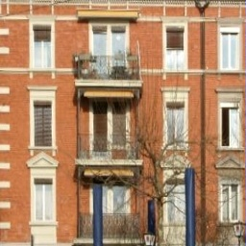
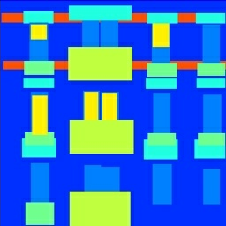
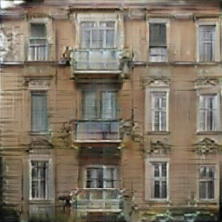
cGAN framework
Ground Truth y0
Input Image x
Input Noise z
Generated Image y
Generator G
Input Image x
D tries to make D(x,G(x,z)) to be 0,
D(x,y0) to be 1;
G tries to make D(x,G(x,z)) to be 1
Discriminator D
Input Image x

Slide 5
Encoder-decoder with skips
Skip
Conv + Batch Normalization + ReLU
Input
DeConv + Batch Normalization + ReLU
Output

Slide 6
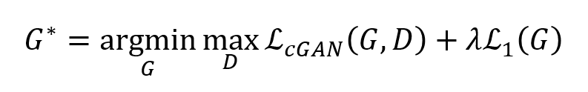
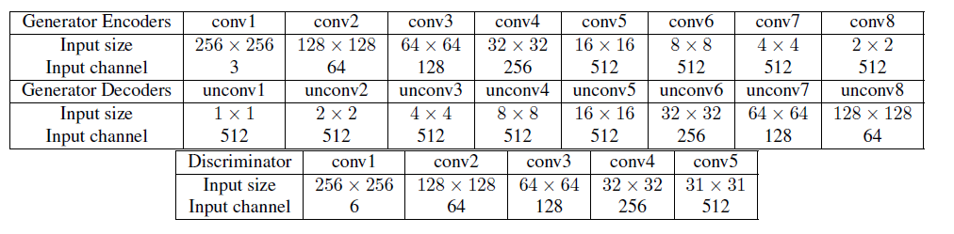
Implementation details
Objective function:
Notes:
The equilibrium is a saddle point of the loss, generator minimize the log-probability that the discriminator being correct.
We used the minibatch stochastic gradient descentsolver, ADAM for optimizationn. The learning rate is set to 0.0002. We use a batch size of 1 and train for 200 epochs for Facades, GoogleMap. Because of time restrictions, the edges to shoes photo and Imagenet dataset is trained for 20 epochs. The simulation is implemented on a GTX TITAN X graphic card.

Slide 7
Datasets
Dataset | Training Samples | Validation Samples | Type
Facades | 400 | 100 | Structural label ↔ Photo
Google Maps | 1096 | 1098 | Map ↔ Aerial Photo
Edge to Shoes | 16K | 200 | Edges → Shoes Photo
ImageNet | 10K | 2500 | Photo → Probability Map

Slide 8
Evaluation metric
It is still an open problem
Plausibility to people:
Examples illustration
Quantitative metric:
Pixel by pixel mean absolute error (MAE) between synthetic image and ground truth

Slide 9
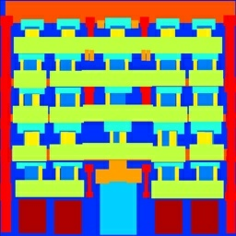
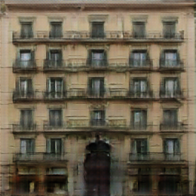
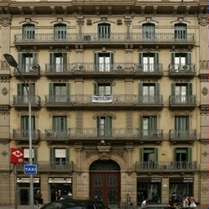
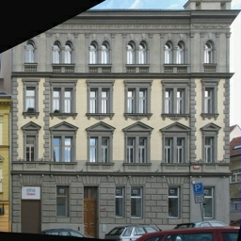
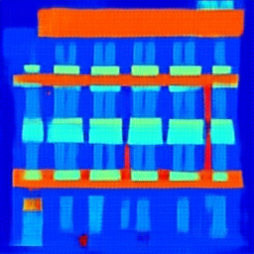
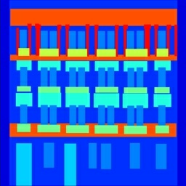
Results
Label to Architecture
Input Output Ground Truth
Architecture to Label

Slide 10
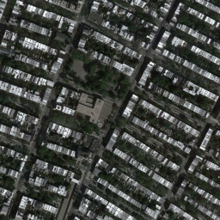
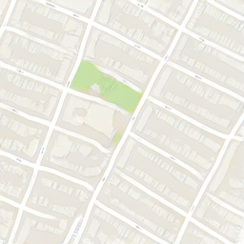
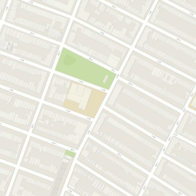
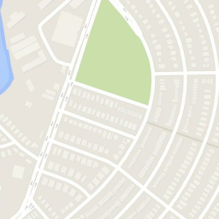
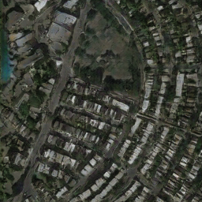
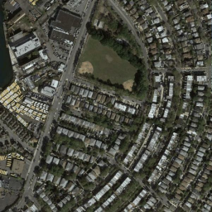
Results
Aerial Photo to Map
Input Output Ground Truth
Map to Aerial Photo

Slide 11
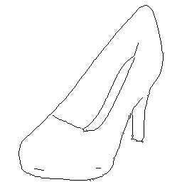
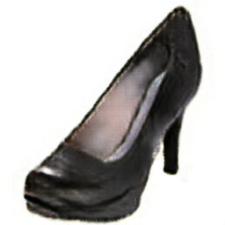
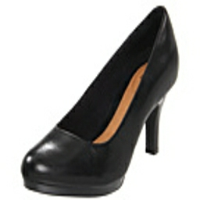
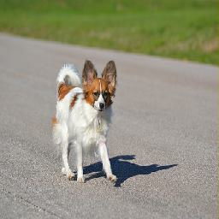
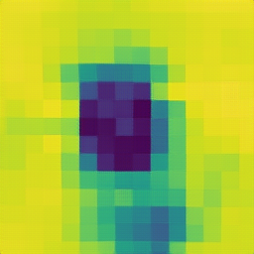
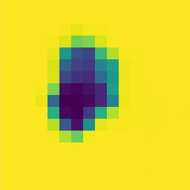
Results
Edge to Shoes
Input Output Ground Truth
Photo to Probability Map

Slide 12
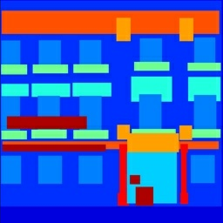
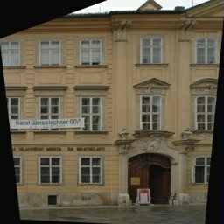
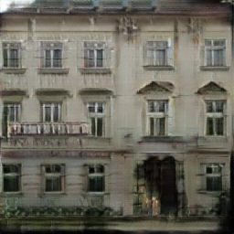
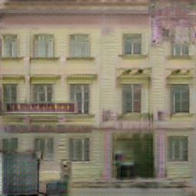
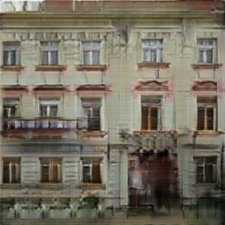
Loss function analysis
Input
Ground Truth
GAN + L1 GAN GAN + L2

Slide 13
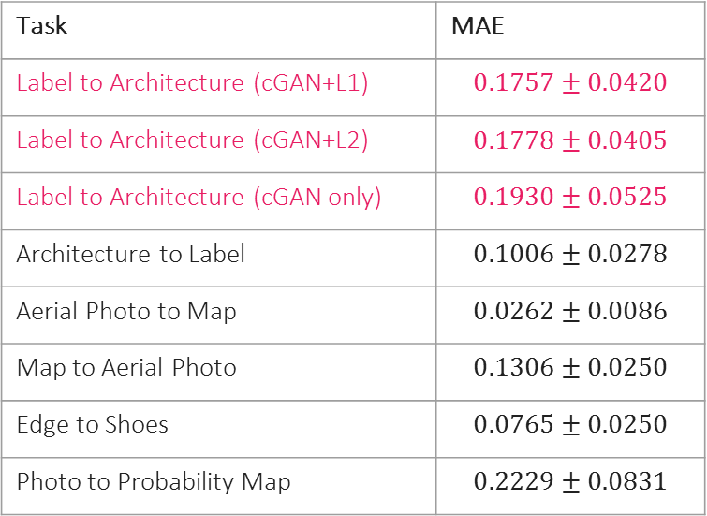
Mean absolute error
Task | MAE
Label to Architecture (cGAN+L1) | $$0.1757±0.0420$$
Label to Architecture (cGAN+L2) | $$0.1778±0.0405$$
Label to Architecture (cGAN only) | $$0.1930±0.0525$$
Architecture to Label | $$0.1006±0.0278$$
Aerial Photo to Map | $$0.0262±0.0086$$
Map to Aerial Photo | $$0.1306±0.0250$$
Edge to Shoes | $$0.0765±0.0250$$
Photo to Probability Map | $$0.2229±0.0831$$

Slide 14
Conclusion
cGAN is a promising approach for image translation
General framework for multiple tasks
Blurry, artifacts issue
Pretrained model for generator
Notes:
Loss doen’t explain why GAN samples are sharp?
Non-convergence in GANs???
GAN loss is a key ingredient??

